Slide 1
Team Black Frog: An improved design for a portable medical-grade refrigeration system
Barath Sundaravadivelan, Jayasreedat Tangella, Lalith Sai Madhav Rayala, Mason Keck, Surya Sudarsan Naveen Ravula

Slide 2
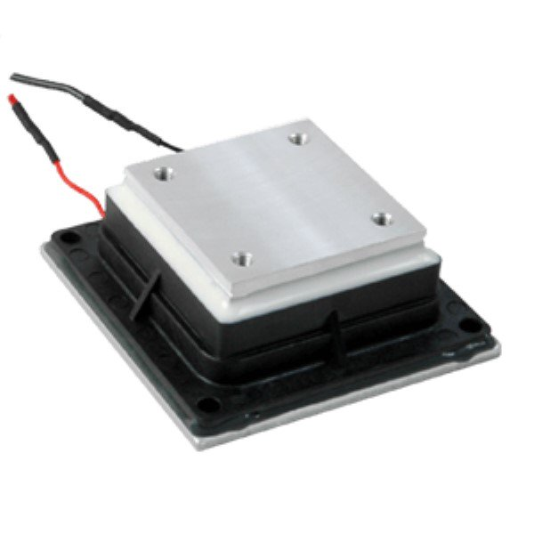
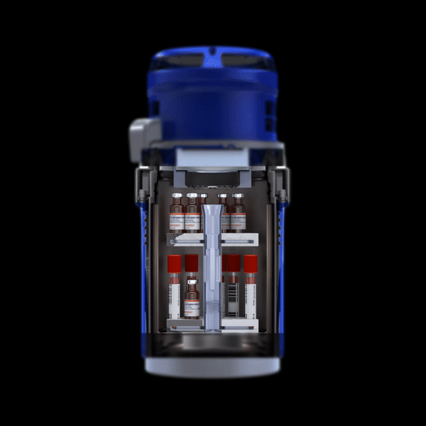
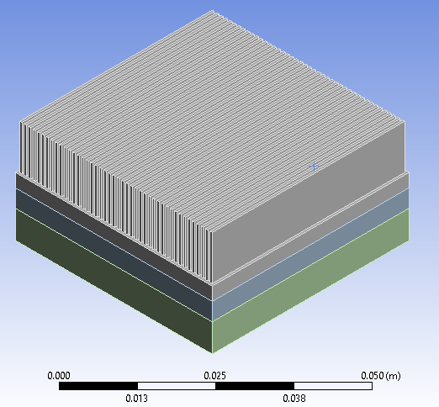
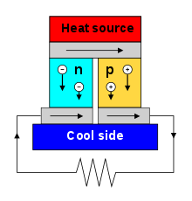
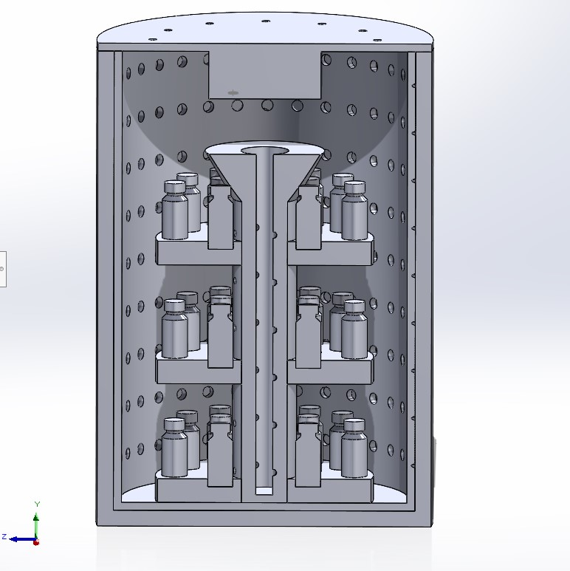
Team Black Frog: An improved design for a portable medical-grade refrigeration system
Background
Motive
Improved Efficiency
By passive cooling the hot side of the Peltier module
using a vapor chamber and heat sink.
Solid State Peltier Cooler
Improved Design
Inspired by Fluidized bed to more efficiently distribute
cold air
Source: https://www.blackfrog.in/how_it_works
Seebeck effect

Slide 3
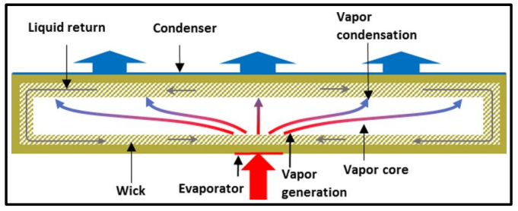
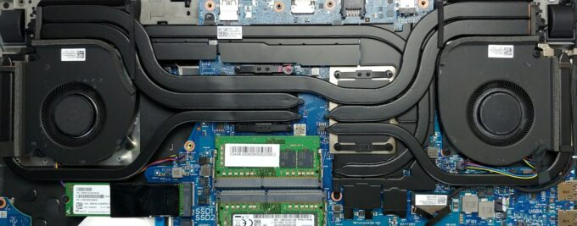
Improved Efficiency
Heat sink
Vapor chamber
Peltier Module
Schematic of a Vapor chamber
Assumptions:
Perfect thermal contact
Effective Heat transfer coefficient of the vapor chamber is assumed to be 1,400 W/m²K. (Source)
Application: Vapor chambers used in laptop

Slide 4
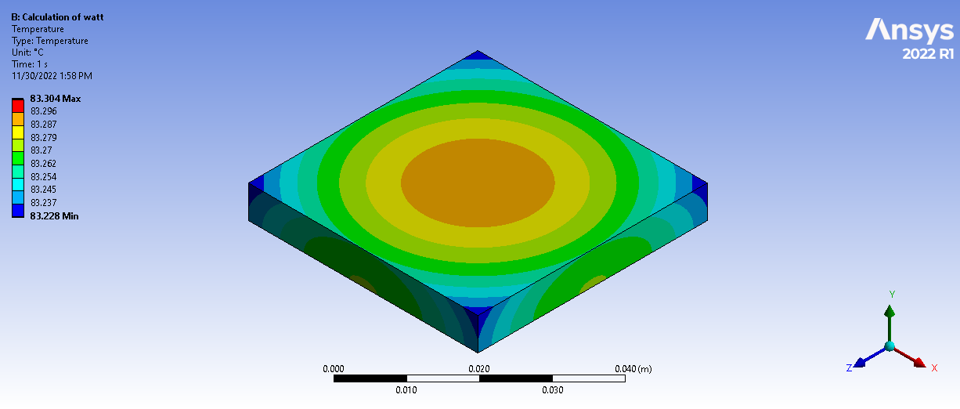
Improved Efficiency
Heat sink
Vapor chamber
Peltier Module
Schematic of a Vapor chamber
Assumptions:
Perfect thermal contact
Effective Heat transfer coefficient of the vapor chamber is assumed to be 1,400 W/m²K. (Source)
Application: Vapor chambers used in laptop

Slide 5
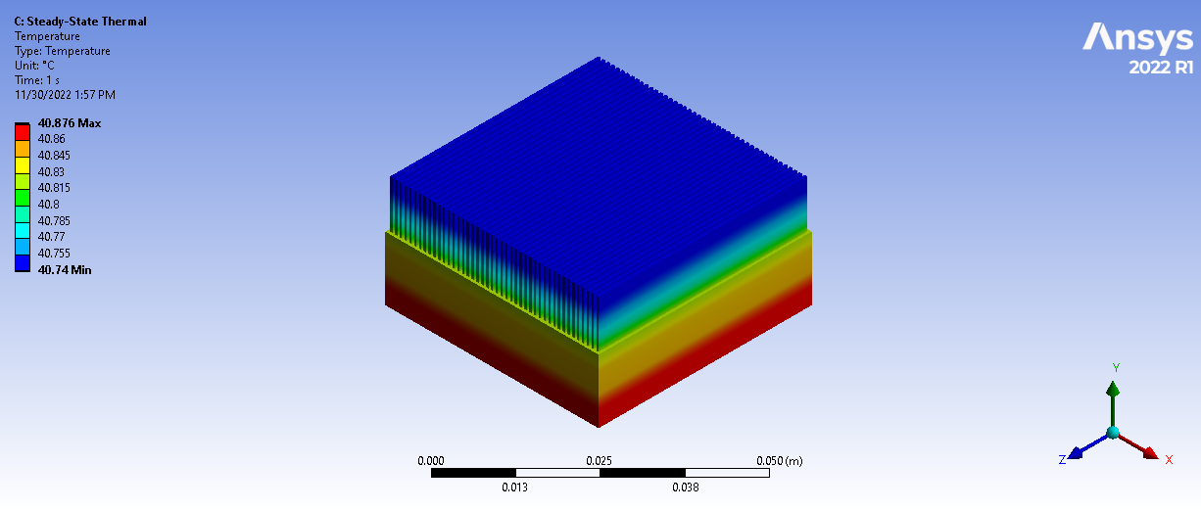
Improved Efficiency
Heat sink
Vapor chamber
Peltier Module
Schematic of a Vapor chamber
Assumptions:
Perfect thermal contact
Effective Heat transfer coefficient of the vapor chamber is assumed to be 1,400 W/m²K. (Source)
Application: Vapor chambers used in laptop

Slide 6
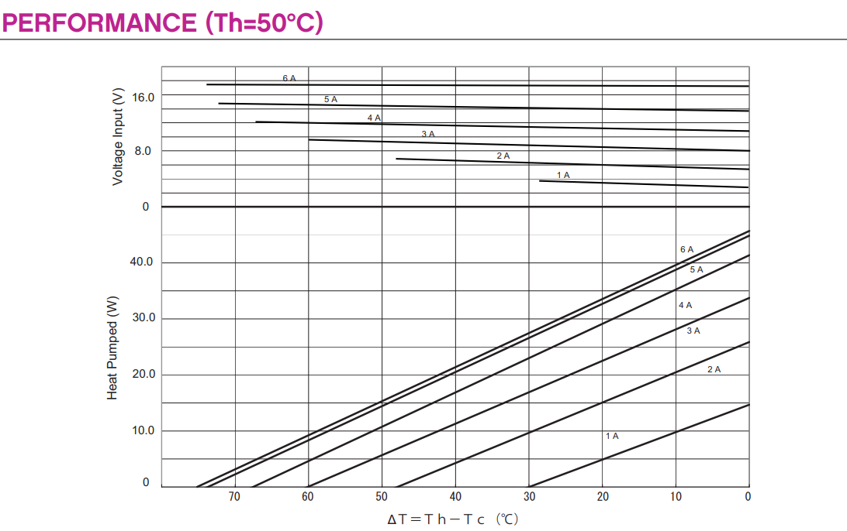
Improved Efficiency
Heat sink
Vapor chamber
Peltier Module
Schematic of a Vapor chamber
Hot-side Temp:
83.304ºC 40.87ºC
Cold-side Temp:
5ºC -10ºC
Assumptions:
Perfect thermal contact
Effective Heat transfer coefficient of the vapor chamber is assumed to be 1,400 W/m²K. (Source)
Application: Vapor chambers used in laptop

Slide 7
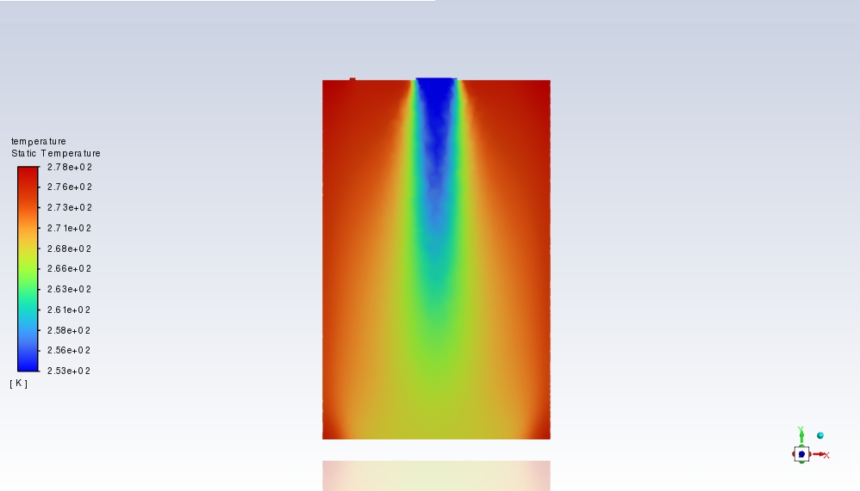
Improved Efficiency
Uneven cold air distribution
Rises need to
Improved Design

Slide 8
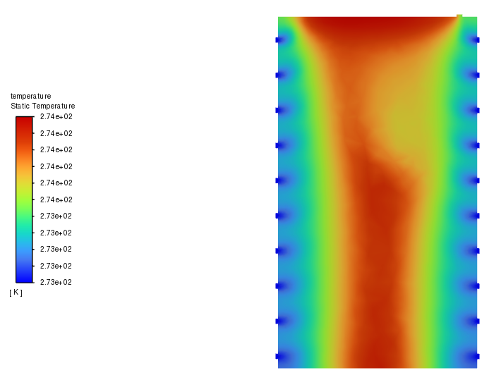
Improved Efficiency
Improved Design
Perforated chamber design: Inspired by Fluidized Bed
This makes our improved design 33% efficient

Slide 9
Improved Efficiency
Improved Design
Perforated chamber design: Inspired by Fluidized Bed
This makes our improved design 33% efficient

Slide 10
Cooling Capacity, Energy Consumption, CO2 Emissions and Cost Analysis
Cooling Capacity:
Cooling Capacity= 0.013tons*
(* Cooling capacity can be changed by varying the voltage and current input to the Peltier module)
Energy Consumption:
Energy Input = 0.023 KWh
Energy Saved per year (when operating 13hrs a day for 300 days) = 20.7 KWh
CO2 Emissions:
CO2 emissions = KWh(Emission/KWh), where emission/KWh is the carbon intensity
Carbon Intensity in Arizona for the year 2021 = 694lb/MWh
For the improved design, CO2 emissions = 0.0147lb per device each year i.e., 30% reduced emissions when operating for 13hrs a day instead of 10hrs a day.
Cost Analysis:
The average electricity rate in phoenix is $0.14
The cost for the improved design is $294 which is $126 less per device per year than the original cost of operating.
Future Works
Do a physical test to confirm ΔT at said operating hot-side temperature and update results.
Work on how to distribute the air in the perforated chamber.

